Slide 1

The Role of Islamic Finance in Financial Inclusion
By: Khalil ur Rahman
Sr. Research Officer
AlHuda Center of Islamic Banking & Economics

Slide 2
Islamic Finance
Islamic Banking
Islamic Insurance (Takaful)
Islamic Microfinance
Sukuk
Islamic Money and Capital Market
Etc . . . . .

Slide 3
What is Financial Inclusion
Financial inclusion means that individuals and businesses have access to useful and affordable financial products and services that meet their needs – transactions, payments, savings, credit and insurance – delivered in a responsible and sustainable way (World-Bank)
Efforts seek to ensure that all households and businesses, regardless of income level, have access to and can effectively use the appropriate financial services they need to improve their lives (CGAP)
Individuals and businesses have access to useful and affordable financial products

Slide 4
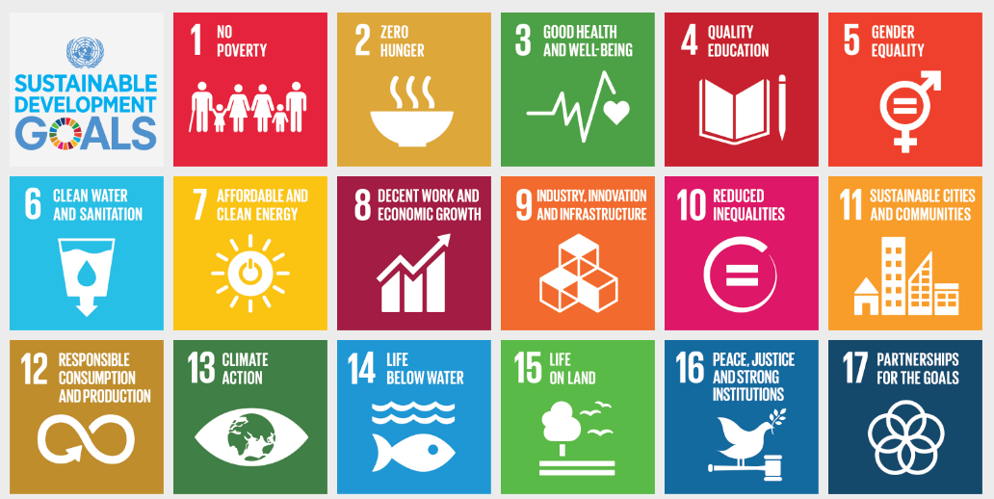
Sustainable Development Goals and Financial Inclusion (CGAP)

Slide 5
Financial Inclusion Statistics
Two Billion people are unbanked
More than 50% of adults in the poorest households are unbanked
Majority of them are Muslims
A transaction account can also serve as a gateway to other financial services, which is why ensuring that people worldwide can have access to a transaction account is the focus of the World Bank Group’s Universal Financial Access 2020 initiative.

Slide 6
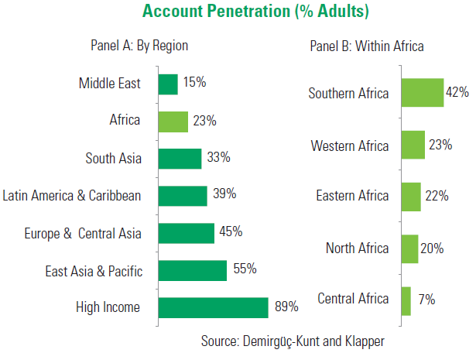
Financial Inclusion Statistics- Africa

Slide 7
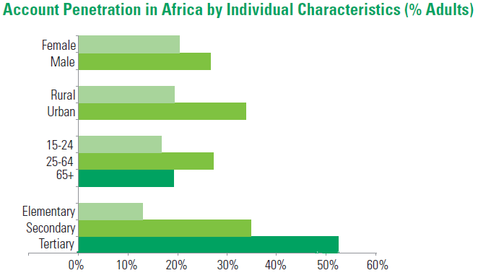
Financial Inclusion Statistics- Africa

Slide 8
Tanzania Position
Today more than five in 10 Tanzanians (54%) are financially included, mainly through mobile money accounts (53%). Tanzania has a largely rural population, which makes access to financial services a challenge and digital solutions ideal. The World Bank reports 70% of the population resides in rural areas, and FII data shows that less than one-third (29%) of the rural population have active accounts (used in the last 90 days), whereas urban citizens are twice as likely to have actives accounts (61%). Approximately 76% of Tanzanians live on less than $2 per day, with three-quarters of Tanzanians employed in the agriculture sector, according to World Bank data. Making gains among these groups is key to improving Tanzanians’ financial lives.

Slide 9
Why Financial Inclusion
Financial inclusion is a key enabler to reducing poverty and boosting prosperity
Make day-to-day transactions, including sending and receiving money;
Safeguard savings, which can help households manage cash flow spikes, smooth consumption and build working capital;
Finance small businesses or microenterprises, helping owners invest in assets and grow their businesses;
Plan and pay for recurring expenses, such as school fees;
Mitigate shocks and manage expenses related to unexpected events such as medical emergencies, a death in the family, theft, or natural disasters; and
Improve their overall welfare

Slide 10
SO . . . .
The benefits of financial inclusion are not only significant for individuals but for economies as well.
financial inclusion is not only positively correlated with growth and employment, but it is generally believed to causally impact growth.

Slide 11
Islamic Finance and Financial Inclusion

Slide 12


